Slide 1
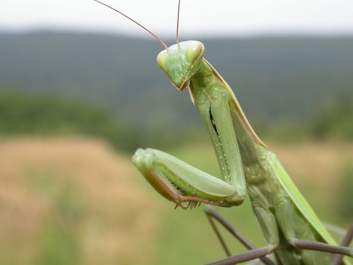
Insects
Eight Major Orders
Pictures from Encyclopedia of Life: eol.org

Slide 2
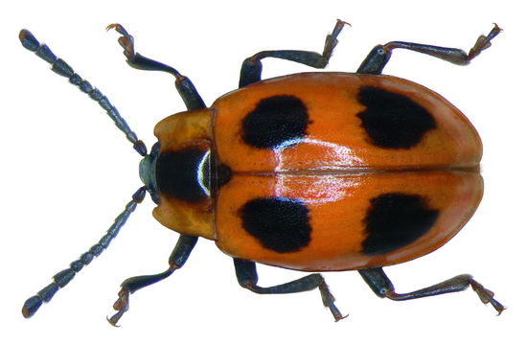
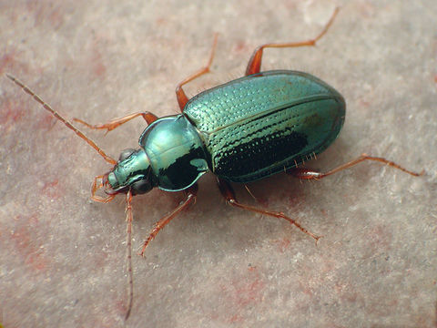
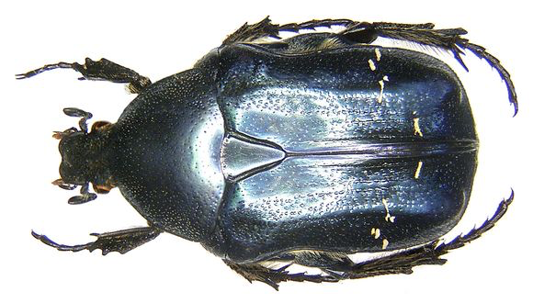
Order Coleoptera (Beetles)
*Hard bodied insects with straight line down back
*Two pairs of wings—one is hard and the other membranous

Slide 3
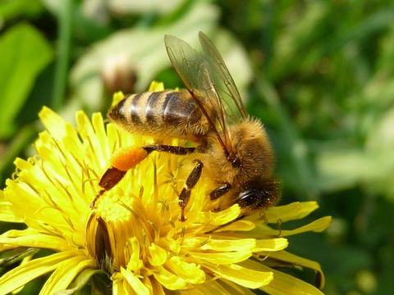
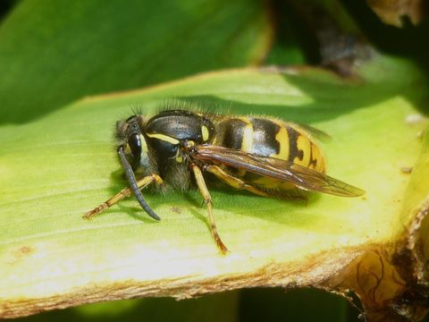
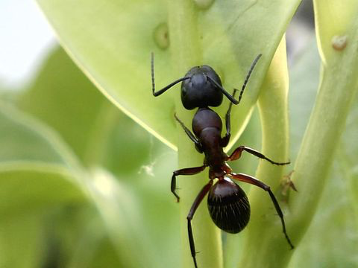
Order Hymenoptera (Bees, Wasps and Ants)
*Generally narrow-waisted
*Two pairs membranous wings (front pair larger)

Slide 4
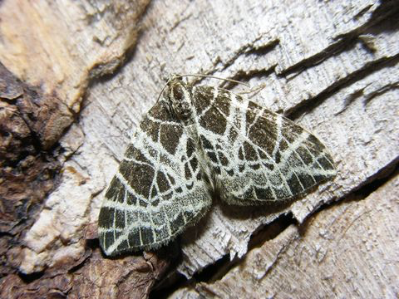
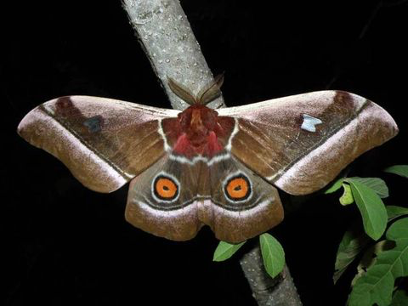
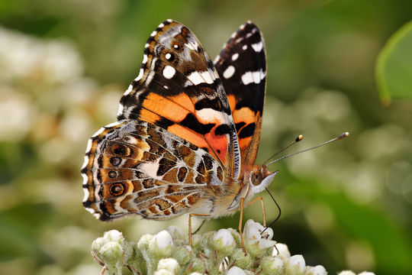
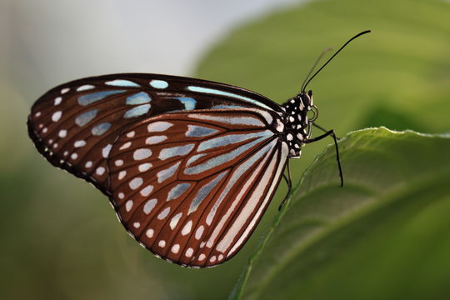
Order Lepidoptera (Butterflies and Moths)—scaly wings
Moths—feathery or threadlike antenna and wings held horizontally
Butterflies—knobbed antennae and wings held above body

Slide 5
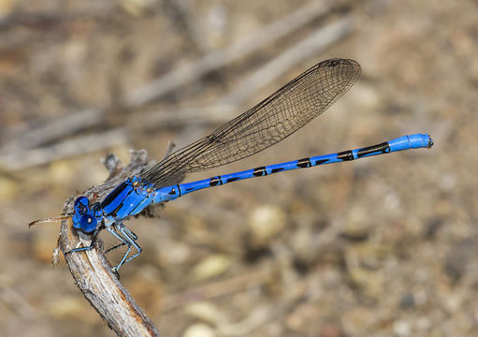
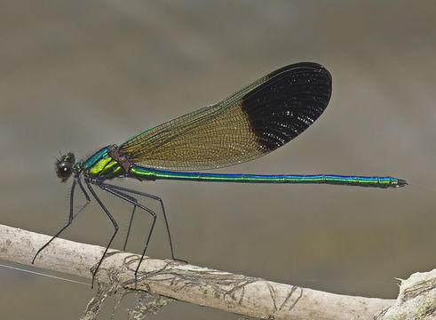
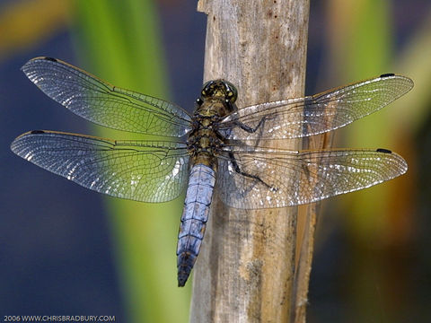
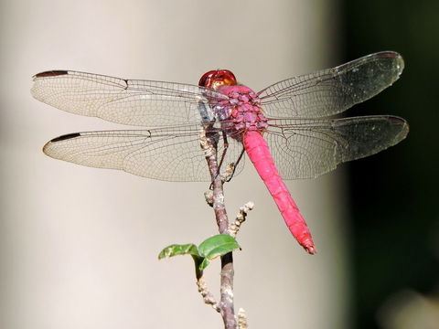
Order Odonata (Damselflies and Dragonflies)—large eyes
At rest:
Damselflies—hold wings above body
At rest:
Dragonflies—hold wings horizontally

Slide 6
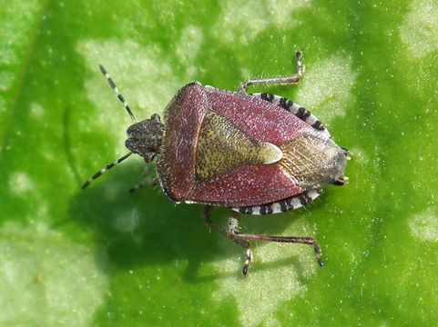
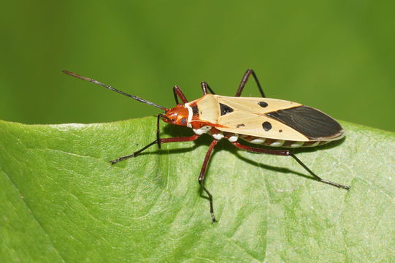
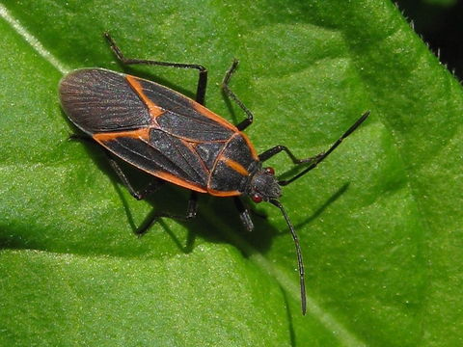
Order Hemiptera (True Bugs)
*Front wings are thick at base and membranous at tip
*Have a “triangle”—where tips overlap

Slide 7
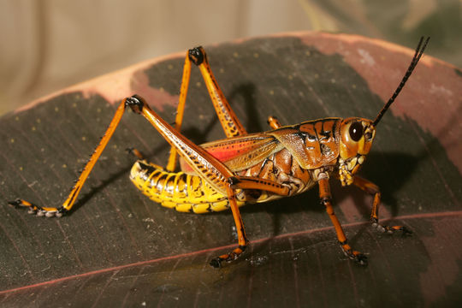
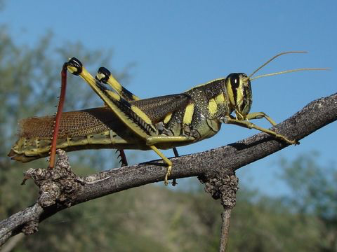
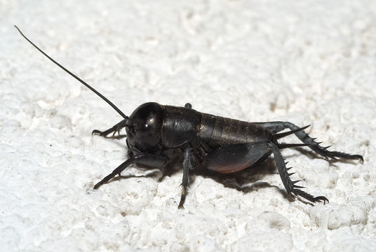
Order Orthoptera (Grasshoppers and Crickets)
*Usually large insect with enlarged hind legs
*Front wings are parchment-like

Slide 8
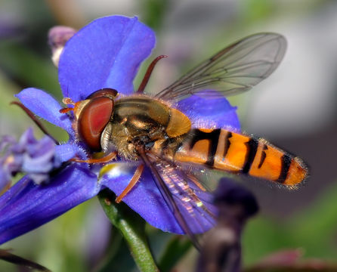
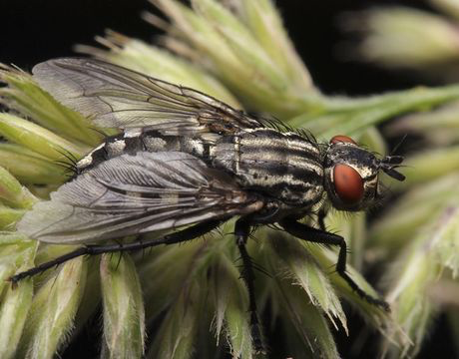
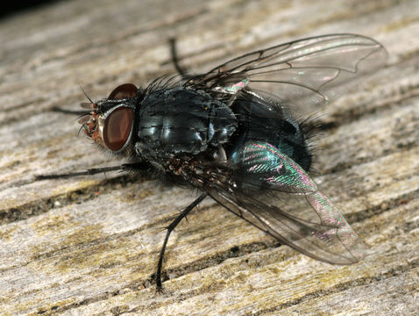
Order Diptera (Flies)
*1 pair of wings (second pair reduced in size)

Slide 9
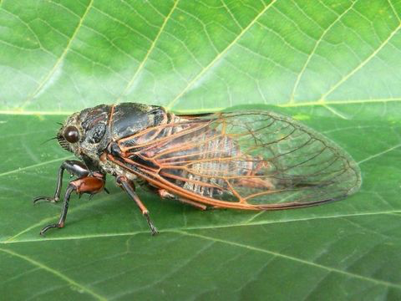
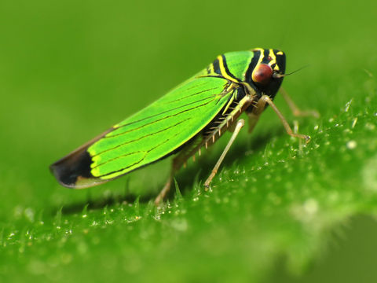
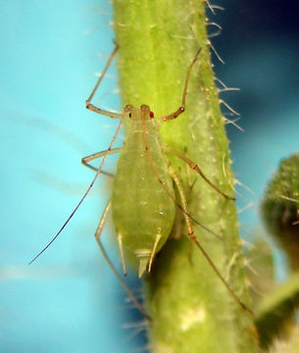
Order Homoptera (Aphids Hoppers, Cicadas)
*Beak attached near rear of head
*Piercing/sucking mouth parts

Slide 10
Pictures from Encyclopedia of Life: eol.org
Slide 1: Praying Mantis: Wikimedia Commons
Slide 2: False Ladybird: Flickr: EOL Images / © Udo Schmidt
Ground Beetle: Tree of Life Web Project / © David R. Maddison
Rose Chafer: Flickr: EOL Images / © Udo Schmidt
Slide 3: European Dark Bee: BioLib.ca / Pavel Sinkyrik
Common Wasp: iNaturalist.org / © Maurice
Carpenter Ant: Flickr: EOL Images / © Marco Spiller
Slide 4: Netted Carpet (Moth): Biopix / Fussingo V.f. Randers, Danmark
Cabbage Tree Emperor Moth: Flickr: EOL Images / © David Bygott
Ceylon Blue Glassy Tiger (Butterfly): Flickr: EOL Images / © TANAKA, Juuyoh
Australian Painted Lady (Butterfly): Wikimedia Commons
Slide 5: Vivid Dancer (Damselfly): iNaturalist.org /© Jim Johnson
River Jewelwing (Damselfly): iNaturalist.or / © Jim Johnson
Black-tailed Skimmer (Dragonfly): Flickr: EOL Images / © Chris Bradbury
Carmine Skimmer (Dragonfly): iNaturalist.org / © Cheryl Harleston

Slide 11
Pictures from Encyclopedia of Life: eol.org
Slide 6: Sloe Bug: Flickr: EOL Images / © Fred’s Uncle
Box Elder Bug: iNaturalist.org / © Anita
Red Bug: Wikimedia Commons / Vengolis
Slide 7: Eastern Lubber Grasshopper: Flickr: EOL Images / © Steve Smith
Bird Grasshopper: Flickr: EOL Images / Saguaro National Park
Field Cricket: Wikimedia Commons / Kulac
Slide 8: Marmalade Hoverfly: Wikimedia Commons
Flesh Fly: BioLib.cz / Jan Moravec
Bluebottle Blowfly: BioImages – the Virtual Fieldguide (UK) / Malcom Storey
Slide 9: New Forest Cicada: BioLib.cz / Frantisek SARZIK
Pea Aphid: Flickr: EOL Images / © Andrew Jensen
Green Leafhopper: Flickr: EOL Images / © Katja Shulz

